Slide 1
AgileSites 3.11 for WebCenter Sites 11g
Michele Sciabarra
michele@sciabarra.com
Sciabarra.com – Just Add Content

Slide 2
WebCenter Sites 11g
Recalling key concepts

Slide 3
Basic Terminology
Asset
All the content is an asset
It is publishabe;
Each asset has a type
Very roughly, a (simple) asset is a record in a table
Flex Assets
Have attributes
Can change their attribute set (definition)
Roughly they are a master-detail table set

Slide 4
Basic Terminology
Element
The underlying code executed by a Template
JSP mostly
Also XML and Groovy
It is NOT an asset – but can be part of an Asset
Template (and CSElement)
It is a (special) asset
It can render a (non executable) asset
They wraps Elements with metadata
It is executable
It is publishabe

Slide 5
The rendering process
It starts always with a Wrapper and c/cid
It will select an asset and a layout
You will apply different elements to different content on the road
Wrapper
Layout
TopNav
SideNav
Detail
Footer

Slide 6
Templates & CSElement
It is an Asset holding an Element
It is Publishable
It contains meta data
It is UNCACHED
Use for rendering logic that embed html in the caller
In is an Asset holding an Element
It is Publishable
It contains meta data
It is CACHED
Use for rendering logic that create separate Pagelets

Slide 7
WCS main concepts
Separate content from presentation
Select an asset (content data)
c is the content type
cid is the content id
Select an element (presentation logic)
pagename is the Element
You always apply an element to an asset
So you need a pagename and a c+cid

Slide 8
Module: Installation
Installing AgileSites 3.11

Slide 9
Prerequisites for AgileSites 3.11
Before starting, you need JAVA 1.7 JDK
WCS Sites 11g does not work with Java 8)
Download JDK 1.7 from the Oracle WebSite
Ensure JAVA_HOME points to the Jdk 1.7
from Windows command prompt:
echo %JAVA_HOME%
from OSX/Linux terminal:
echo $JAVA_HOME

Slide 10
Download the starter manually
Create a folder: e.g. starter
Download this zip in the folder:
http://agilesites3-repo.s3.amazonaws /releases/11g/agilesites.zip
it is a single URL, do not split!
Unzip it inside the folder
Execute the agilesites script
Either .sh for OSX/Linux or .cmd for Windows

Slide 11
Alternative download using git
Get git for your operating system
Decide for a folder name: e.g. starter
Execute this command from the parent folder:
git clone http://github.com/sciabarra/AgileSites3.11 starter
it is a single command line, do not split!
Cd in the folder and execute the agilesites script
Either .sh for OSX/Linux or .cmd for Windows

Slide 12
Install WebCenter Sites 11g
Everything starting with > is should be executed at the agilesites prompt
Downloading Sites
> sitesDownload <username> <password>
you must use your oracle credentials
Install Sites:
> sitesInstall
Log into Sites:
http://localhost:11800/cs/

Slide 13
Use an IDE for editing
Generate eclipse configuration files
> eclipse
you can now edit it with Eclipse
You can also use other editors like IntelliJ or Netbeans
The project is a standard java-only project

Slide 14
Control the Server
Control the server
> server status
> server stop
> server start
Generate a script for starting sites:
> server script

Slide 15
Generate a new WebSite and install it
Decide for a name and a prefix: e.g. Starter St
> asNewSite Starter St
Install Agilesites and the newly created site
> asSetup
Log into sites and create a new page named Home
You can see now it as:
http://localhost:11800/cs/Satellite/starter/

Slide 16
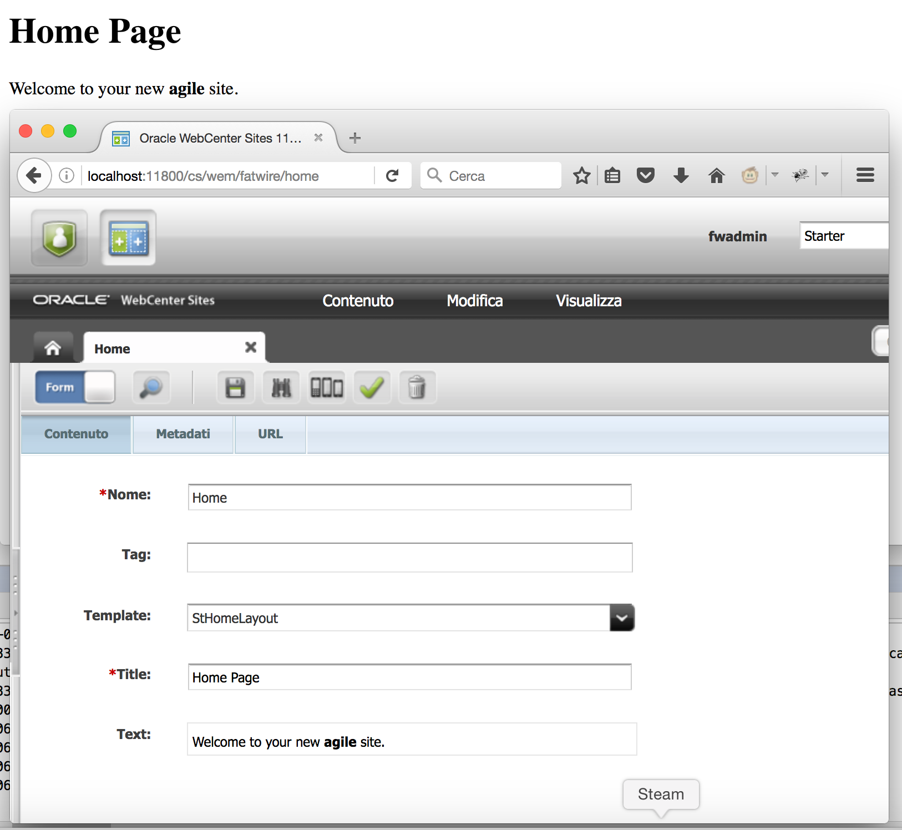
Lab
Install WebCenter Sites
Generate a new site
Install agilesites and the new site
Check you get the ErrorPage
Create a page named Home
Check you get the Home Page
Goal: Installing WCS and create a new agile Site

Slide 17
Module: Site Structure
What is in a Site?

Slide 18
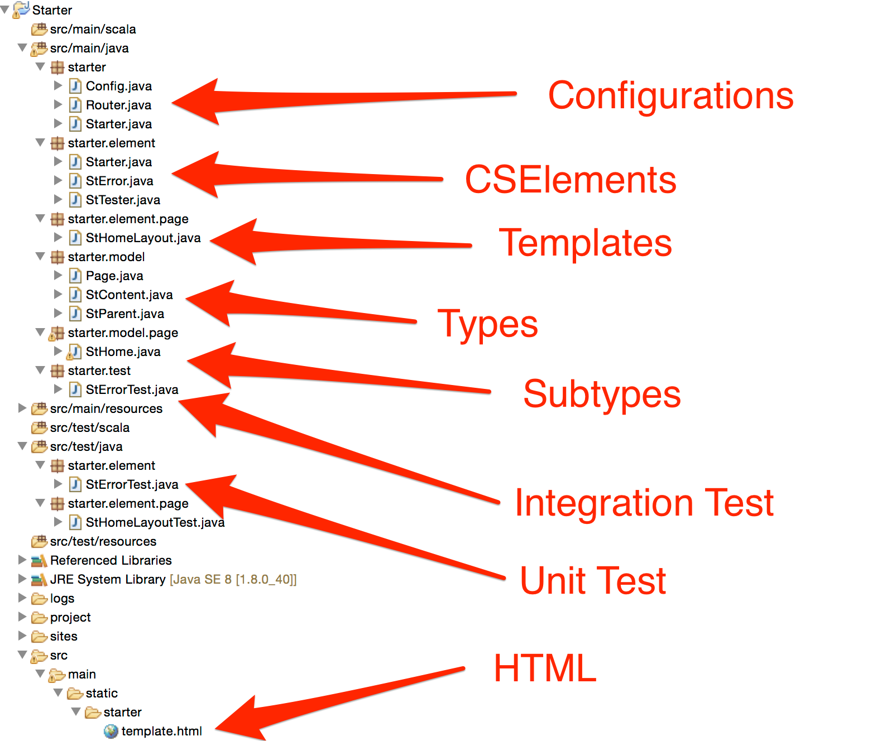
Site Structure

Slide 19
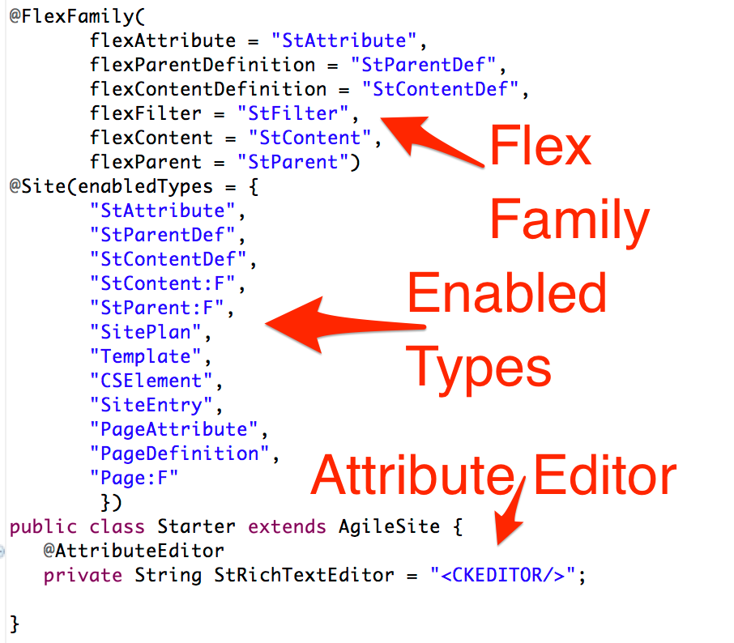
Main Site Definition

Slide 20
Configurations
Router
decode/encore urls
programmatically
route get an url and calls a CSElement
link get an asset and returns an URL
Config
maps type names in attribute names
(workaround for a limitation of the Sites API)

Slide 21
Basic Content Model
Types:
Page
the built in Page type
StContent
a content type of a flex family
StParent
a parent type of a flex family
Subtypes
StHome
A subtype of Page for rendering the Home Page

Slide 22
Basic Templates & CSElements
CSElement
Starter
the wrapper
StError
default error page
StTester
test runner for integration tests
Templates
StHomeLayout
template for the home page
Mockup
template.html
used by all the templates ans cselements

Slide 23
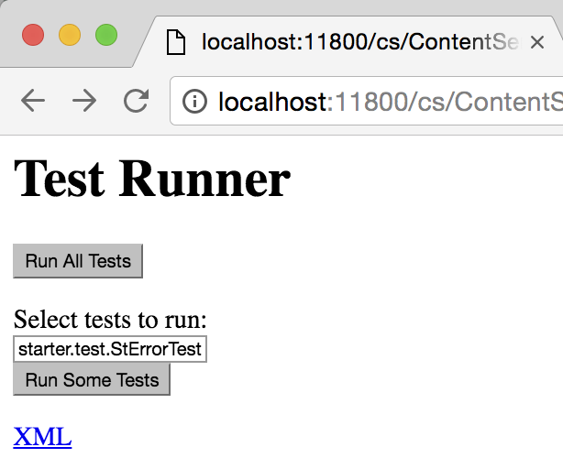
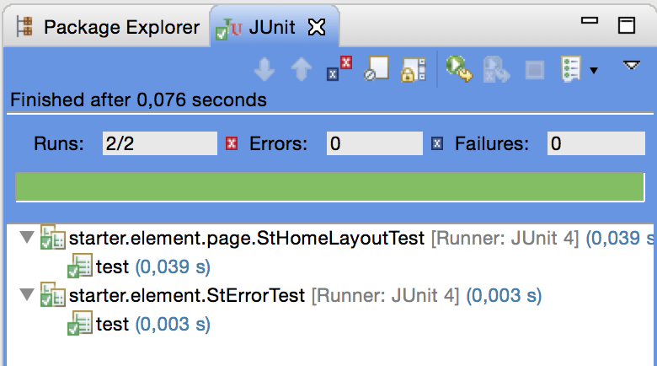
Tests
Unit Tests
StErrorTest
StHomeLayoutTest
Integration Tests
StErrorTest

Slide 24
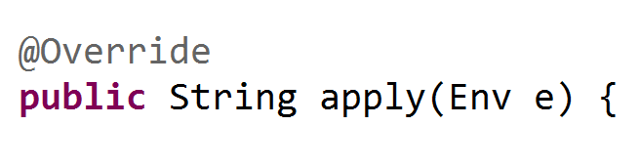
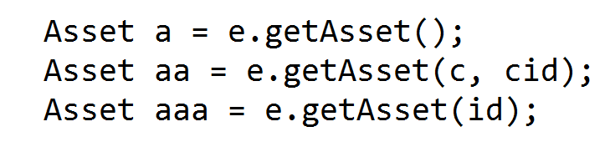
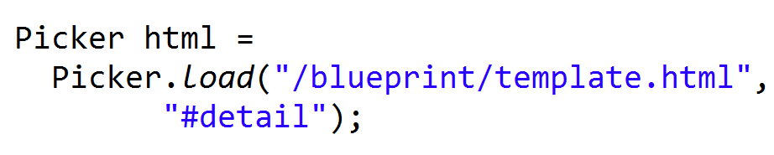
AgileSites ABC
Env:
Asset:
Picker

Slide 25
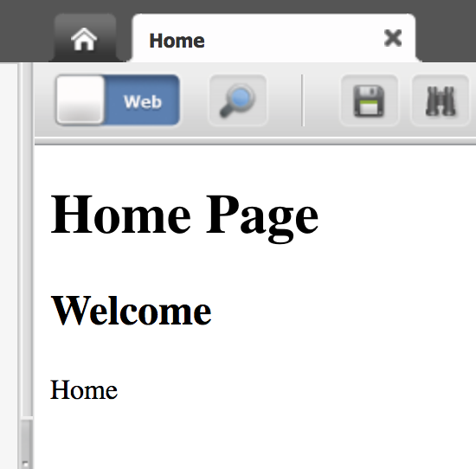
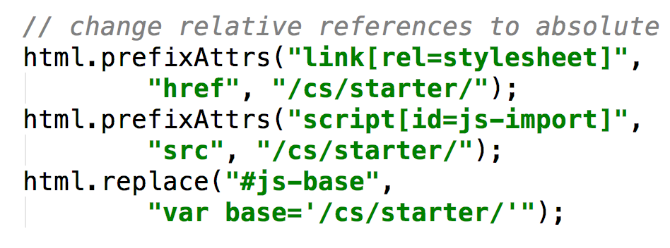
Lab
Add an attribute
Change the template
Write a test
Deploy the Site
Add the statics from the url below and fix html
Familiarize with the project structure and the development workflow.
http://agilesites3-repo.s3.amazonaws.com/starter.zip

Slide 26
Beginning Content Modelling
Lean how to create your content model

Slide 27
Hierarchy
Type:
Page
PageDefinition
Subtype: Home
PageAttribute
Attribute:
StText
StHome
Attr Types
Attribute:
StTitle
StText
StTitle

Slide 28
Attributes
Attributes can be
single
multiple
AttributeEditors
Stock
Custom
Attributes have different types
String
Text (long string)
Image
Asset

Slide 29
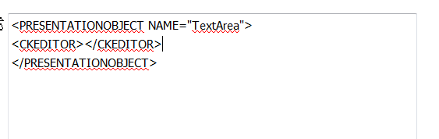
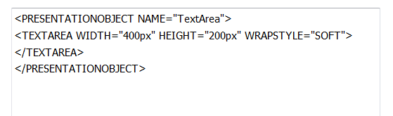
Attribute Editors
Attribute editors define editing options for attributes
TEXTAREA
CKEDITOR
Defined with an XML file
Unfortunately
Documented in developer manual

Slide 30
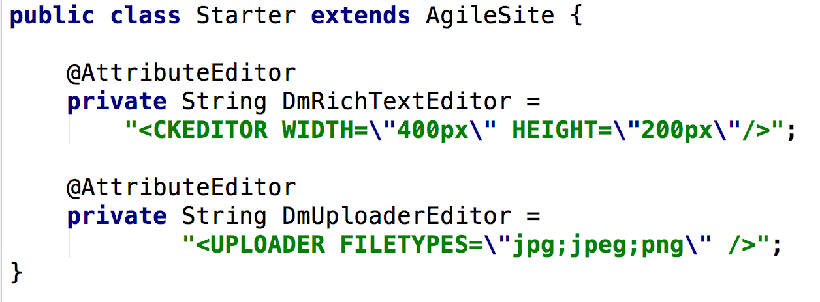
Attribute Editors
Normally declared in the Site configuration file
Need to specify only the details of the attribute editor
Name is the field name

Slide 31
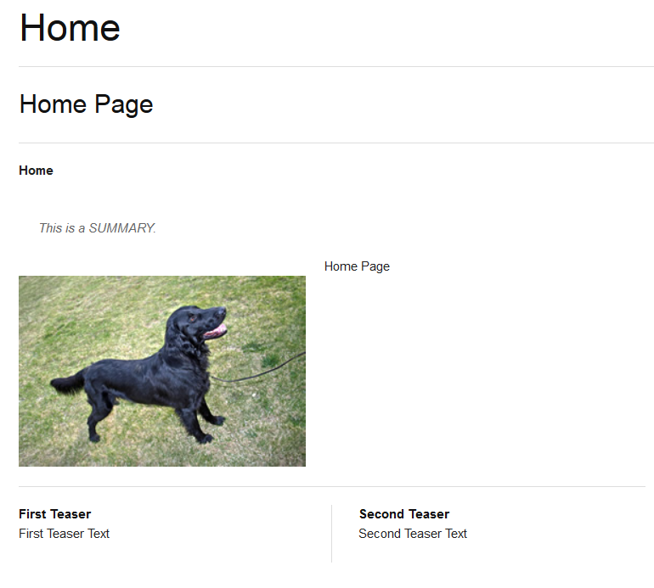
Attributes
Title
Subtitle
Sumary
Image
Detail
TeaserText
TeaserTitle

Slide 32
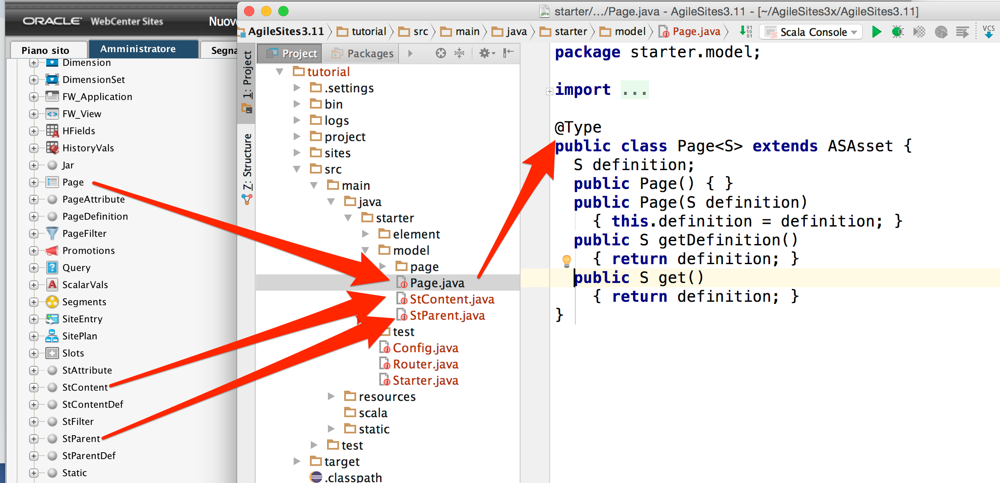
Flex Family Content Types
A standard wrapper class is required to represent them in Java

Slide 33
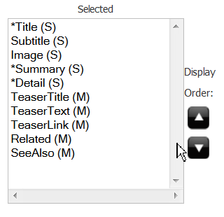
Definitions
Definitions
A set of Attributes
Used by contents to define their attributes

Slide 34
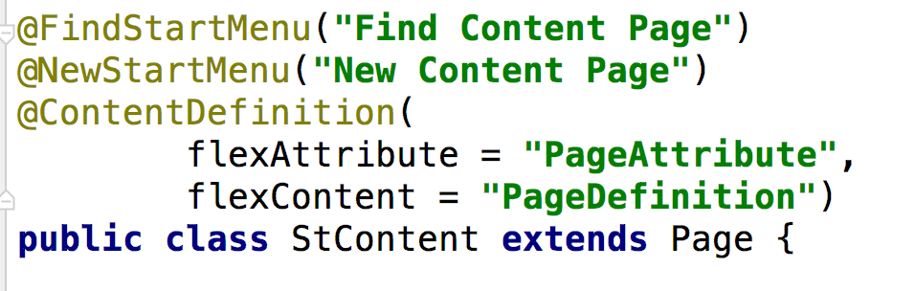
Definitions
You need a definition to be a container of attributes
Note it is a subtype so extends a type

Slide 35
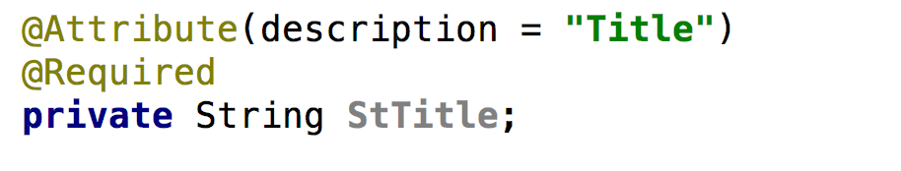
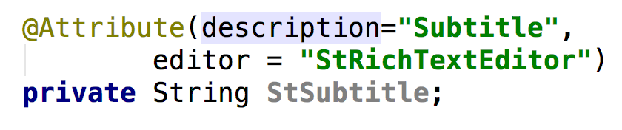
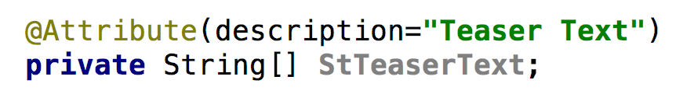
Attributes
Text with description, mandatory
Text with attribute editor
Attribute multiple

Slide 36
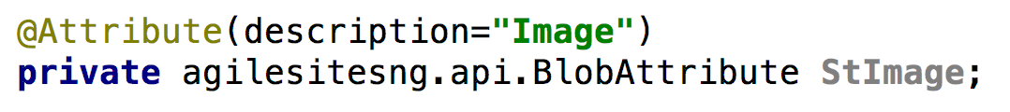
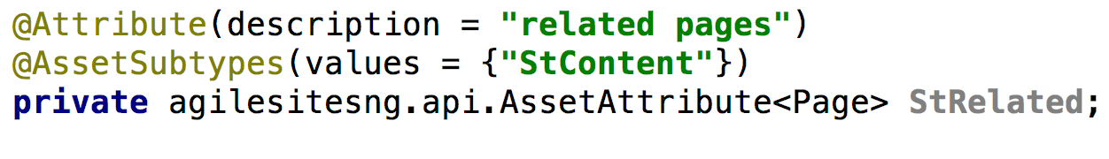
Attributes, continue
Blob Attribute
Asset Attribute

Slide 37
Lab: Create Attributes
Define 2 attribute editors
CKEDITOR
TEXTAREA
Define attributes
Subtitle: single, string,
Summary: text, single TEXTAREA
Detail: text, single CKEDITOR
Image: single, blob
TeaserTitle: multiple, string
TeaserText: multiple, text
Related: asset, multiple
SeeAlso: asset:, multiple
Place them in the Content definition
Objective:
Learn about attributes, definitions and attribute editors
You will create all is needed to render a whole page

Slide 38
Placing Attributes in a mockup
From static html to a dynamic website

Slide 39
The fine art of HTML cutting
The common part of
web page
Wrapper
The specific part of each layout
Layout

Slide 40
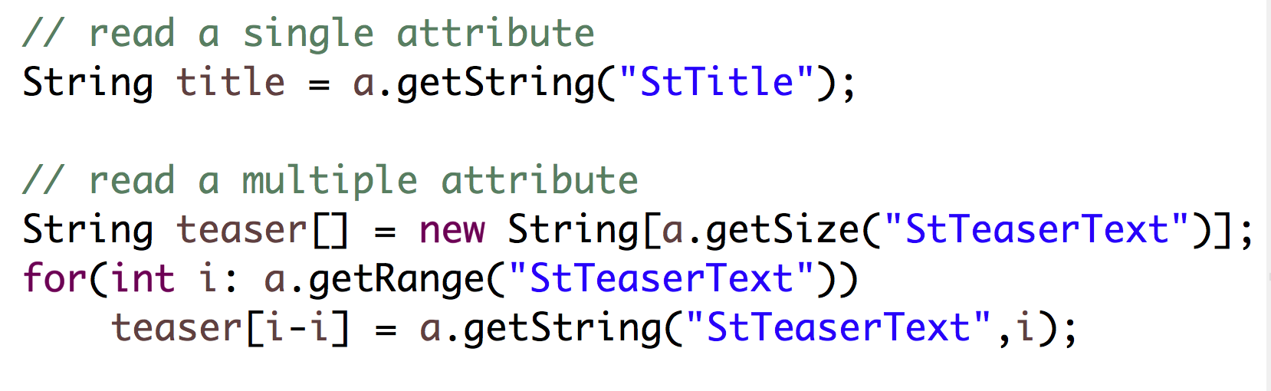
Extracting attributes
Load as asset (default the current)
Read the attributes of the asset:

Slide 41
Mockup in Java with Picker
Pick the html
Picker p = Picker.load("/blueprint/template.html")
Moustache
{{Attribute}}
Replacements
p.replace("#location", a.getString("Value"))

Slide 42
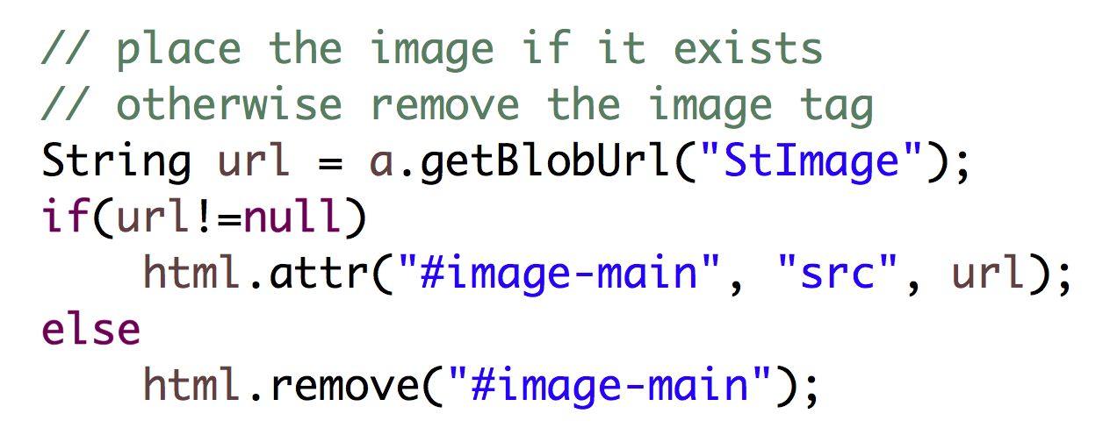
Render the image

Slide 43
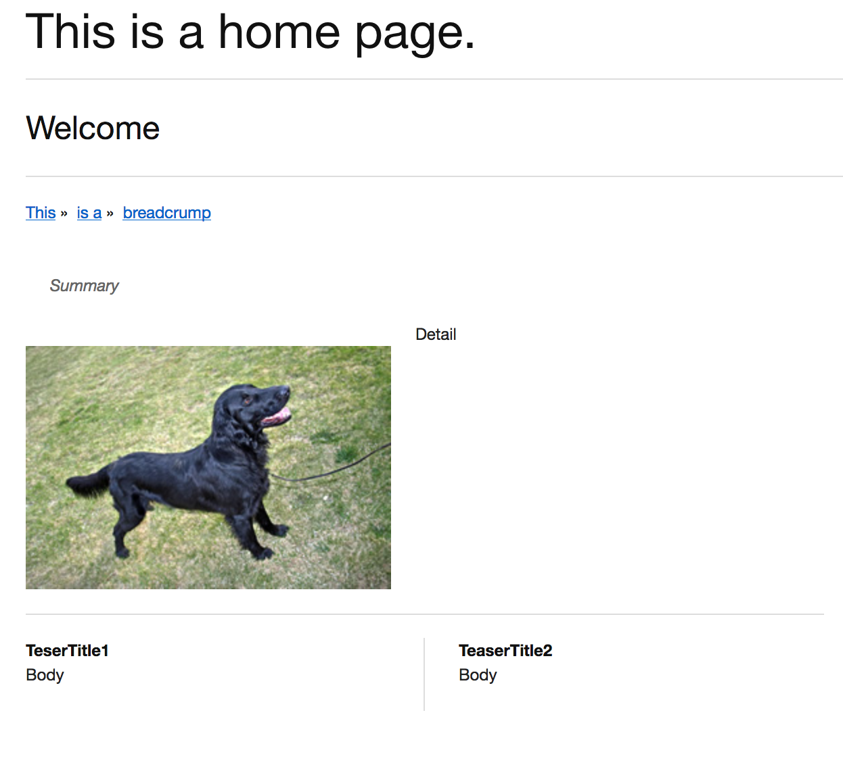
Lab: populate the mockup
Implement the following attributes:
Summary
Details
Teaser Title
Teaser Text
Image
Related
SeeAlso
Goal:
Populate your html mockup with content

Slide 44
Rendering Links
Let's see how Implement navigations

Slide 45
What is a link in Sites anyway?
You always link to ASSETS
So you get the ASSET then extract the URL to.
Link to myself:
e.getAsset().getUrl()
Not very useful in practice, so you use attributes or siteplan. For example:
url = a.getAsset("Related").getUrl()
a = e.findOne("Page", arg("name", "Home"); url = a.getUrl();

Slide 46
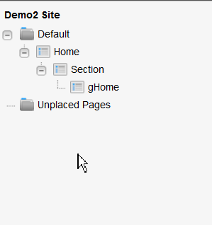
SitePlan
Navigating the siteplan
Get the nodeid first
Siteplan functions
Path
Children
Whole tree
Others (check siteplan:*)
Path
getsitenode
chidren

Slide 47
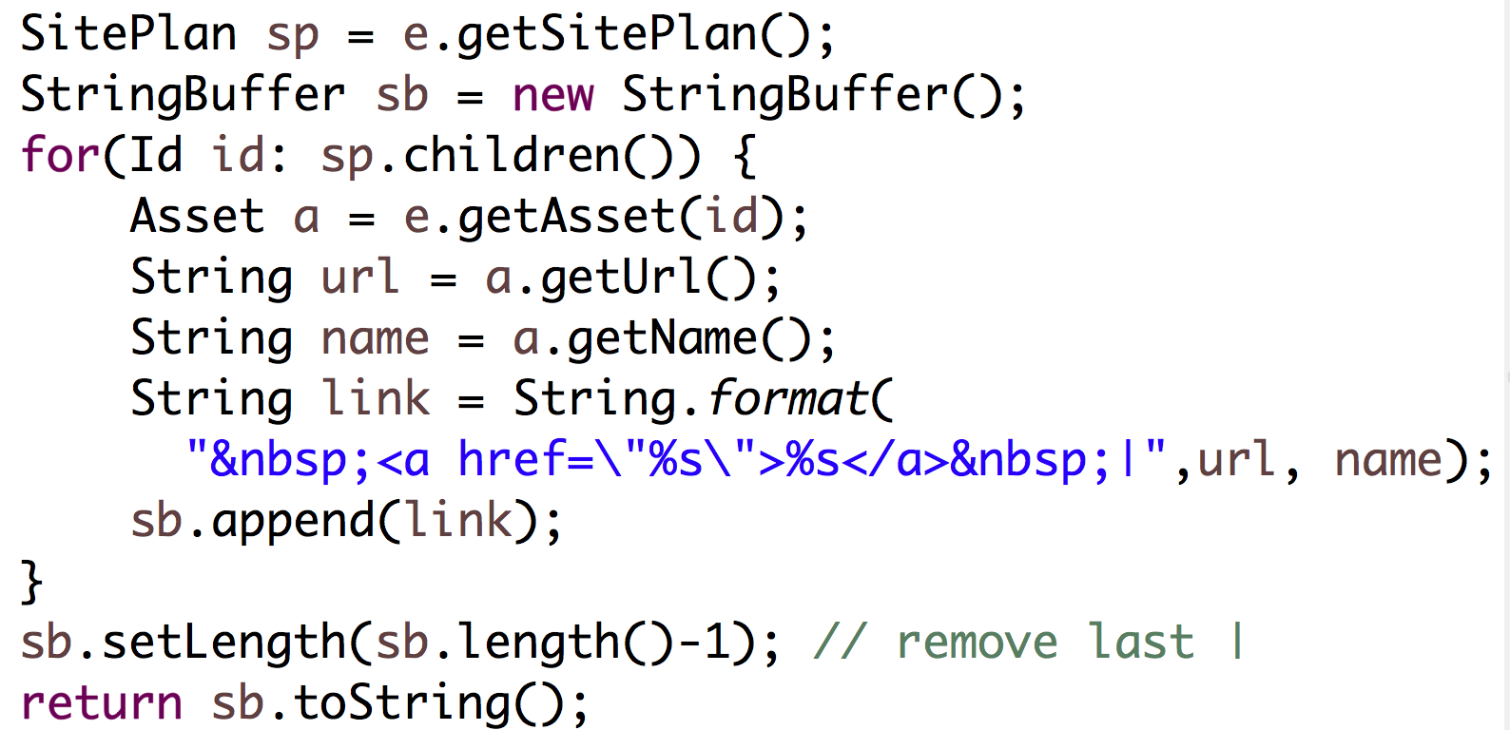
Rendering top menu

Slide 48
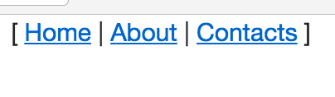
Lab: rendering top menu
Write a method implementing the topmenu
Show links to the first level pages in the siteplan
Goals: learn how to create links and navigate the siteplan

Slide 49
Rendering Inner elements
Nesting is the key for leveraging the content model

Slide 50
A composite view
Not everything that is needed to render a web page is an attribute of a single asset
Very often you have a set of assets that refers each other
The golden rule of Sites template development
In a template render only ONE asset
If you find another asset. change the current asset (c/cid) and call another template

Slide 51
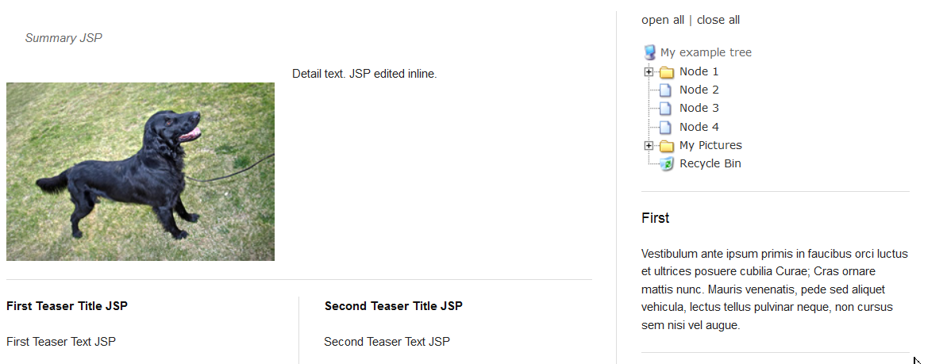
Spot the difference
Fields of a different asset – need to call a different template
Fields of the same asset – no need to change template

Slide 52
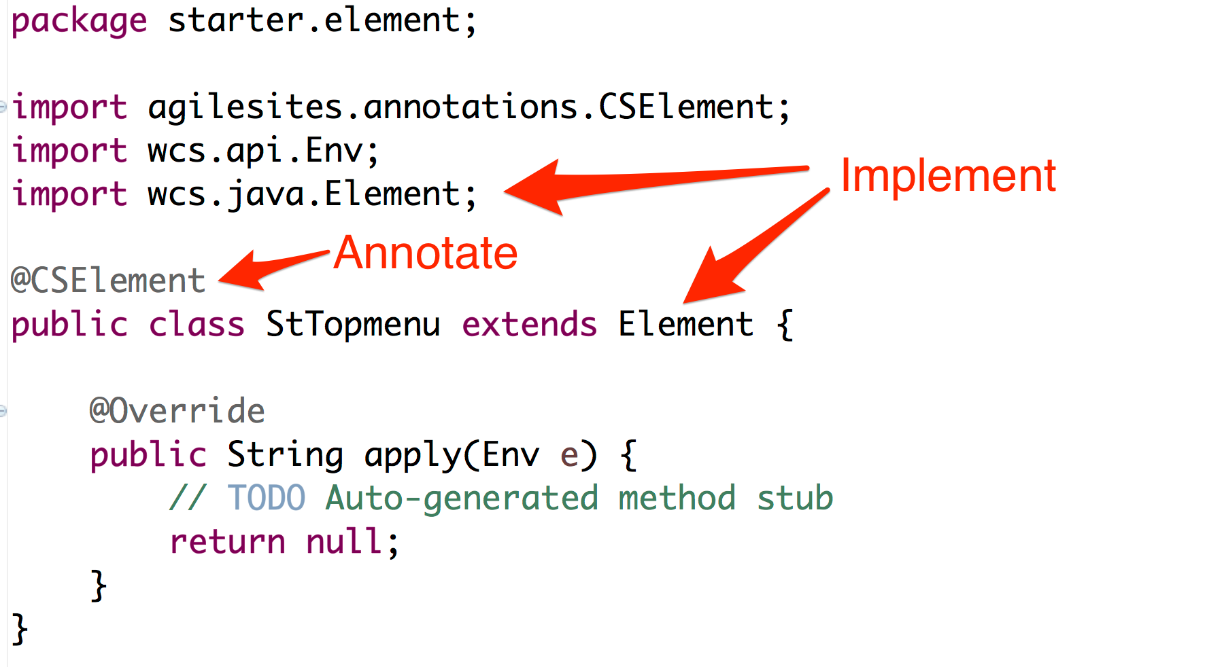
Create a new CSElement

Slide 53
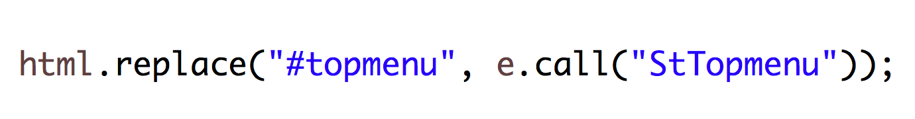
Invocation of a CSElement
Use the Env:
Note the invocation is a String that can be placed
Invocation happens actually later
It is not a procedure call, but a note to the system to use the output of a cselement for rendering

Slide 54
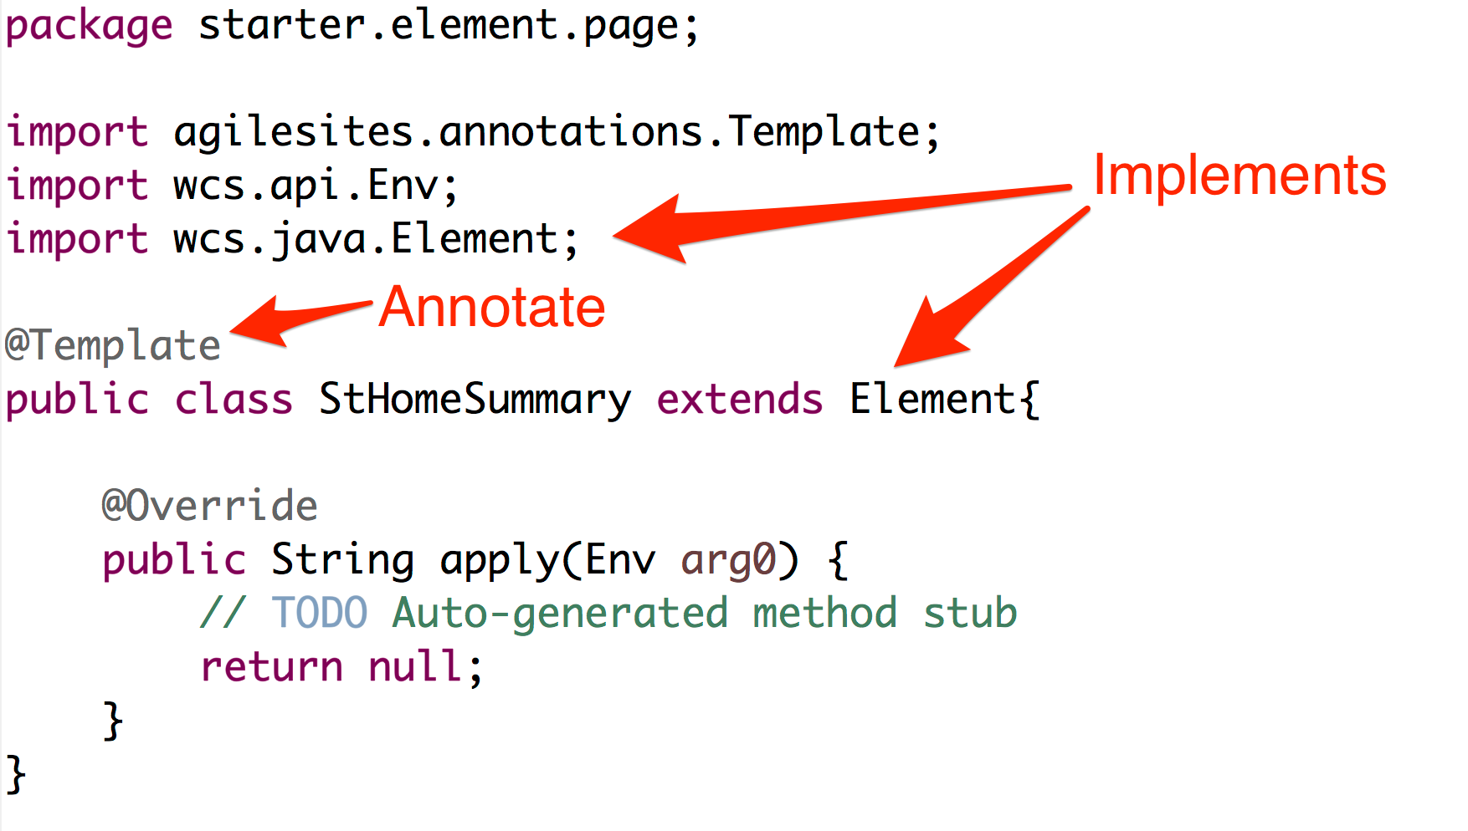

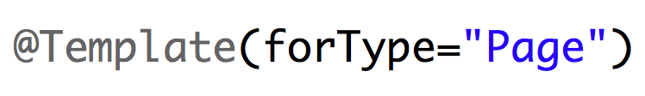
Create a new template

Slide 55
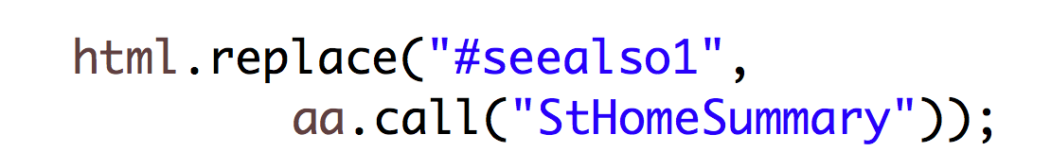
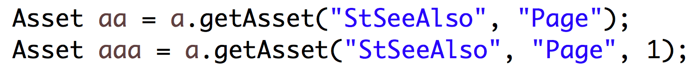
Invocation of a Template
You always need an asset to invoke the template
You replace the call, but do not forget the cache
Generally you get the asset from an attribute
you need to specify the type of the asset

Slide 56
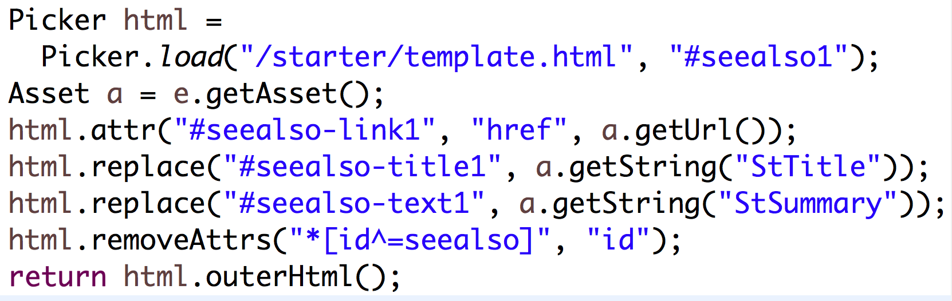
Lab: calling templates and elements
Create a CSElement and move the topmenu logic in it
Create a Template and use it to render the SeeAlso blocks
At the end you will render the summary with a separate template
Code for the
StHomeSummary
Template

Slide 57
Slot
Drag and drop other assets in the current page

Slide 58
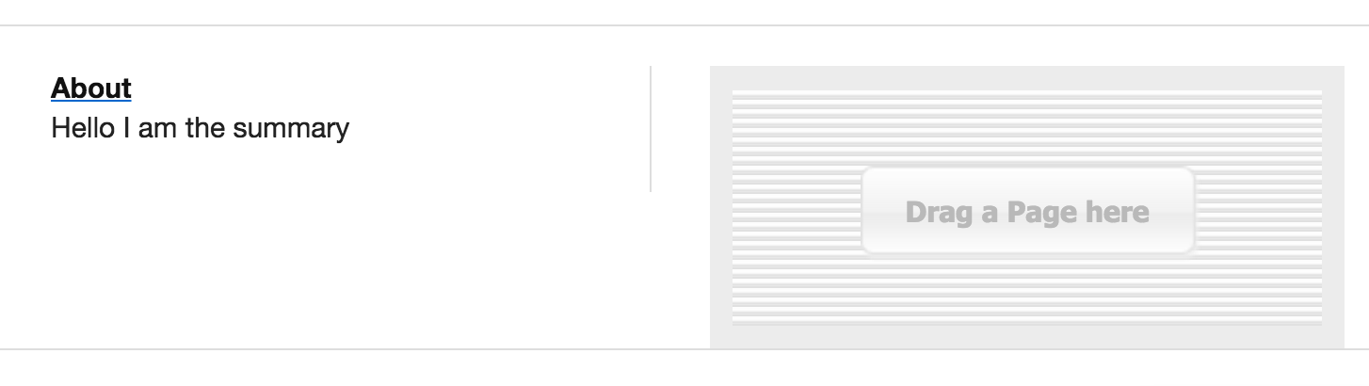
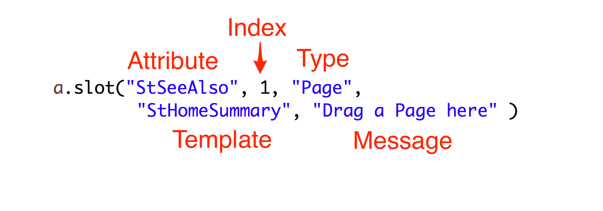
Creating a slot

Slide 59
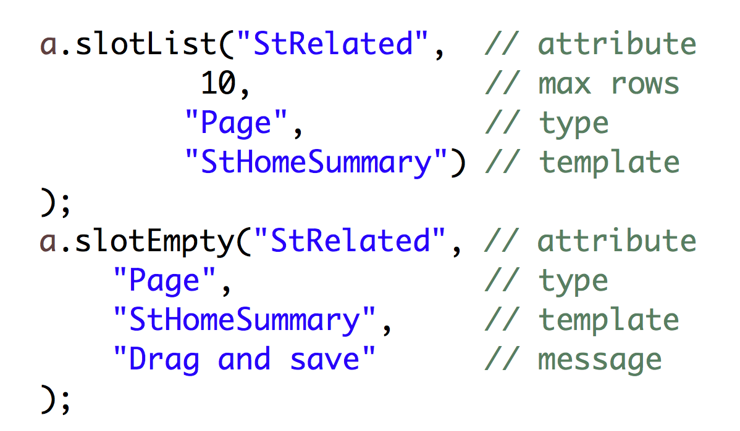
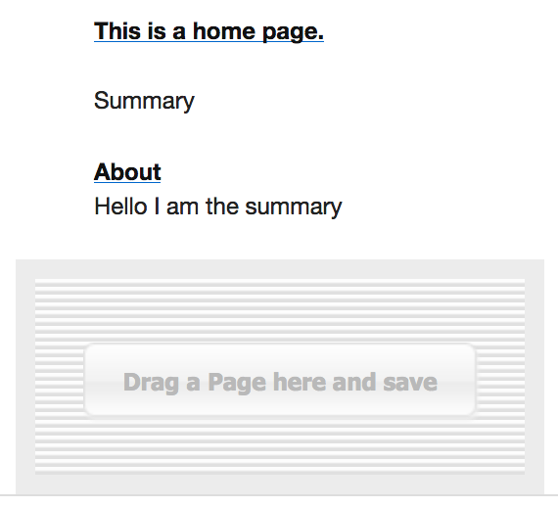
slotList/slotEmpty

Slide 60
Lab: Slot
Replace the calls as slots
Implement the related slot list
In this lab you will create slots for drag-n-drop of content

